Slide 1


Estimating population sizes;
the intersection between Statistics, Ecology and Computation
Cal F-J, under the supervision of Professor David Borchers
Data provided by Matt G. Nowak

Slide 2
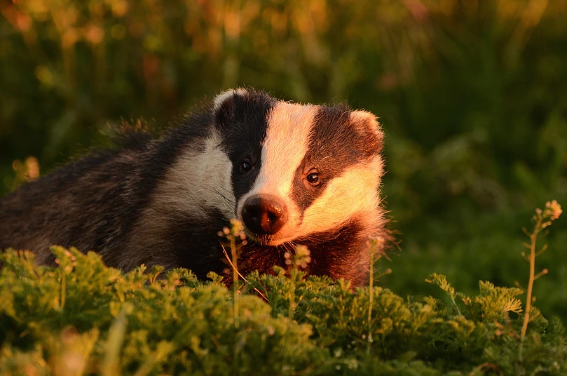
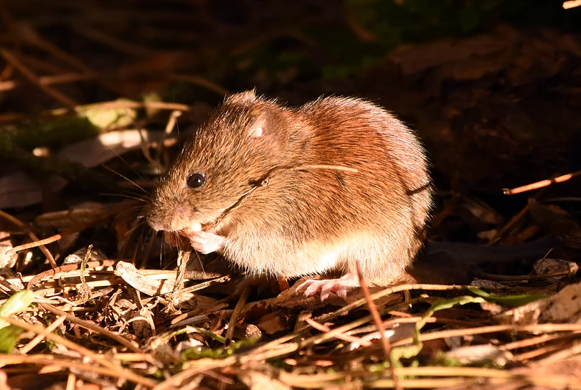
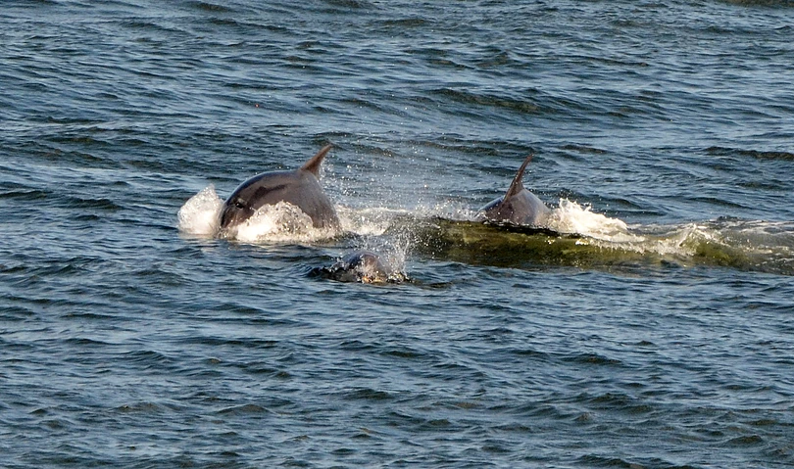
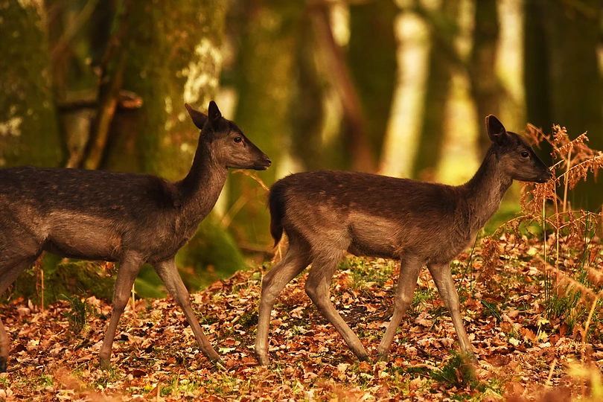
Motivation
Why spend time, resources, research funds and employ experts just to count animals?
Simple Curiosity
Determine if a species is endangered
Allows us to monitor population sizes over time:
Is population size declining, stable or recovering?
Determine if wildlife management projects are effective
Personally – They’re cute, why not save them?
Pictures taken by Stephen Buckland

Slide 3
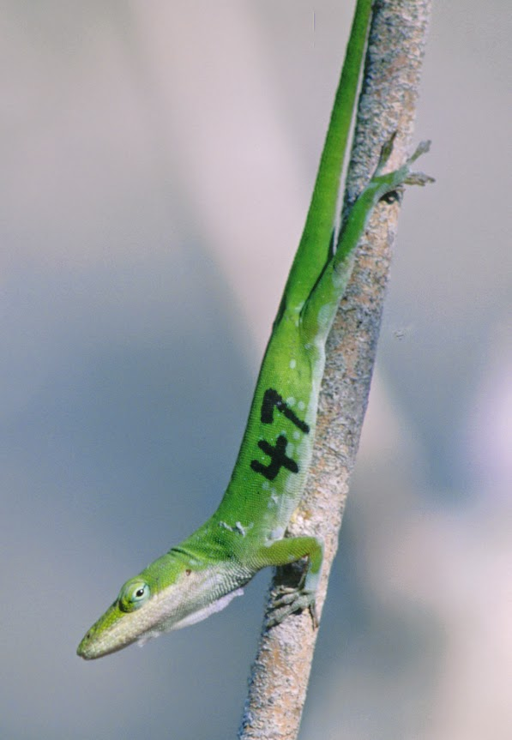
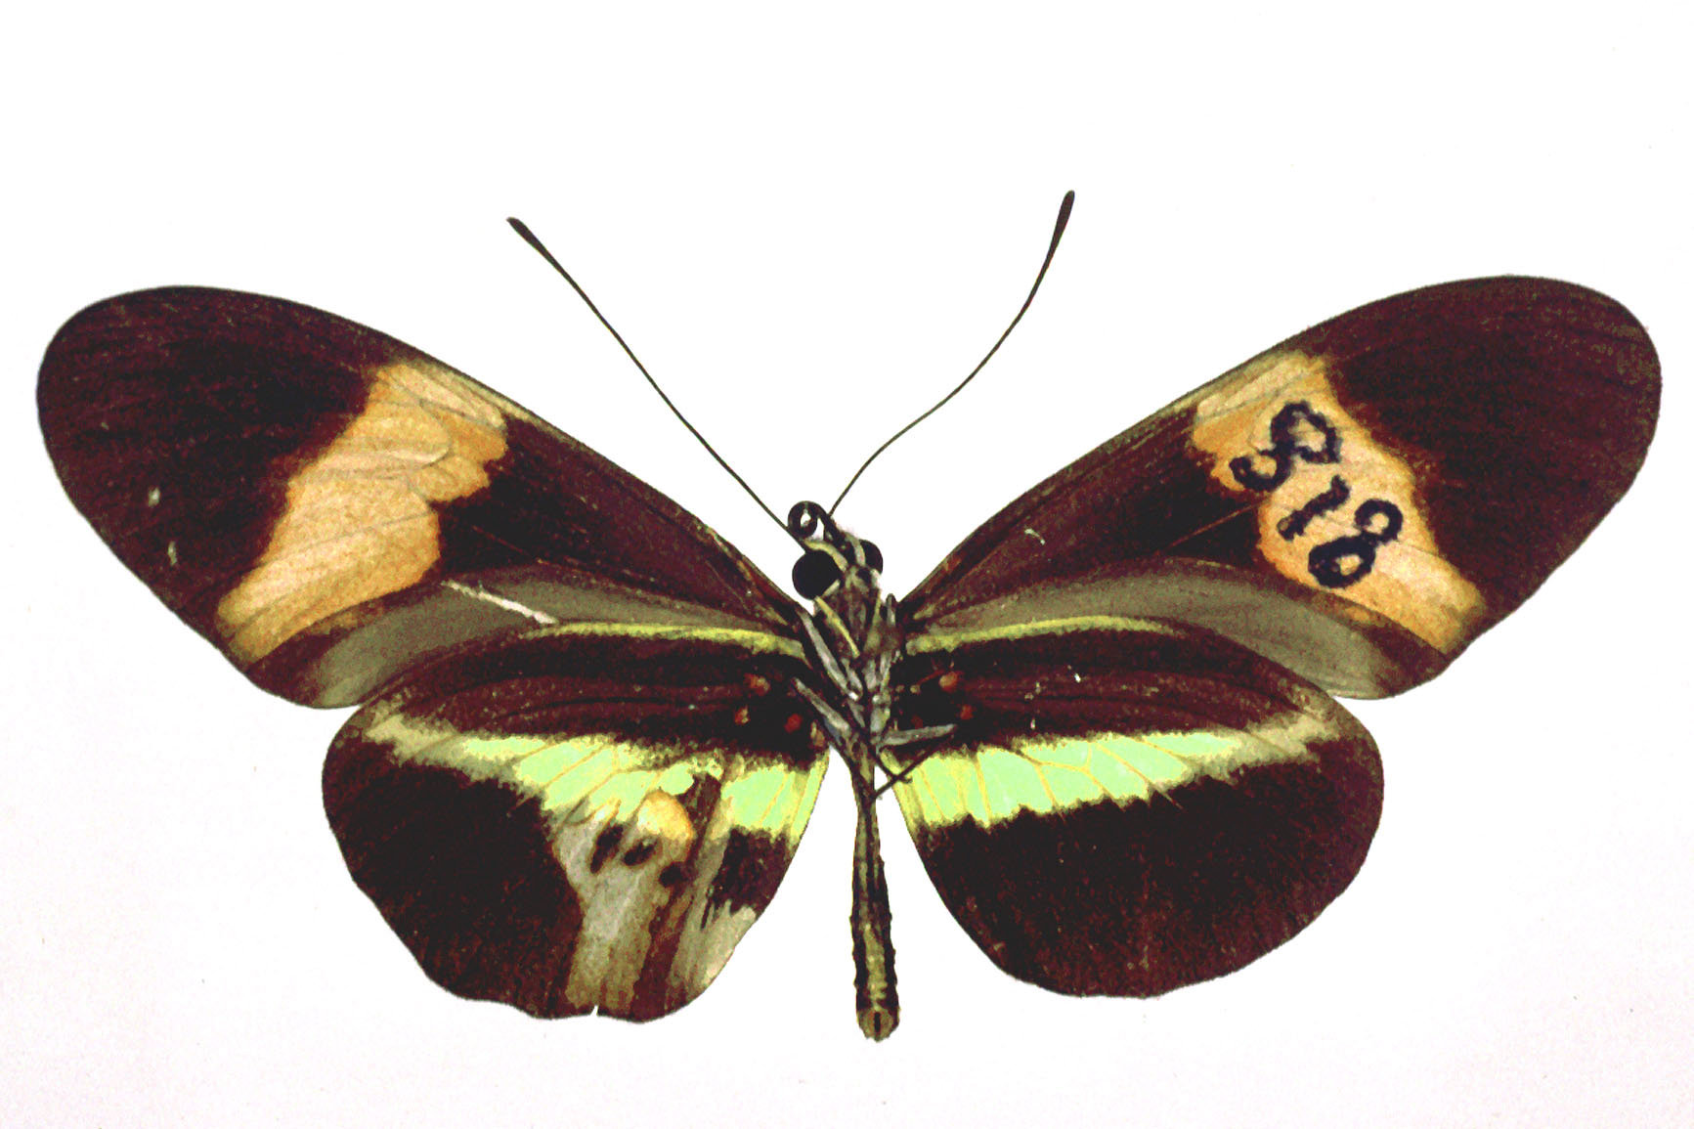
Standard Methodologies
Census
Plot Sampling
Mark-Recapture
Removal Analyses
Plot Sampling
Distance Sampling:
Strip Sampling
Traditional Distance Sampling
Mark-Recapture Distance Sampling
2D Detection functions
Others

Slide 4
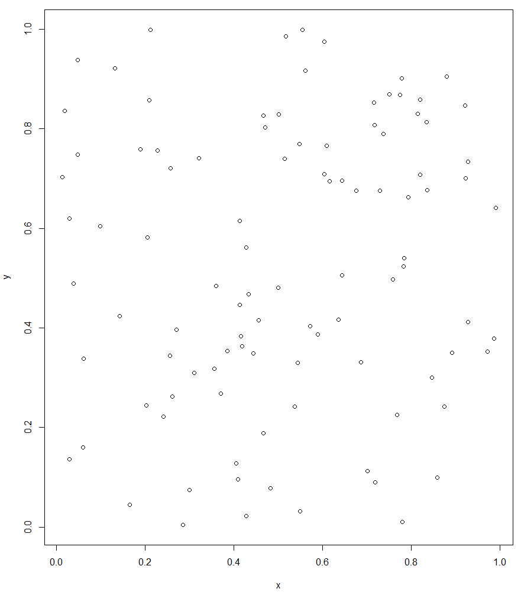
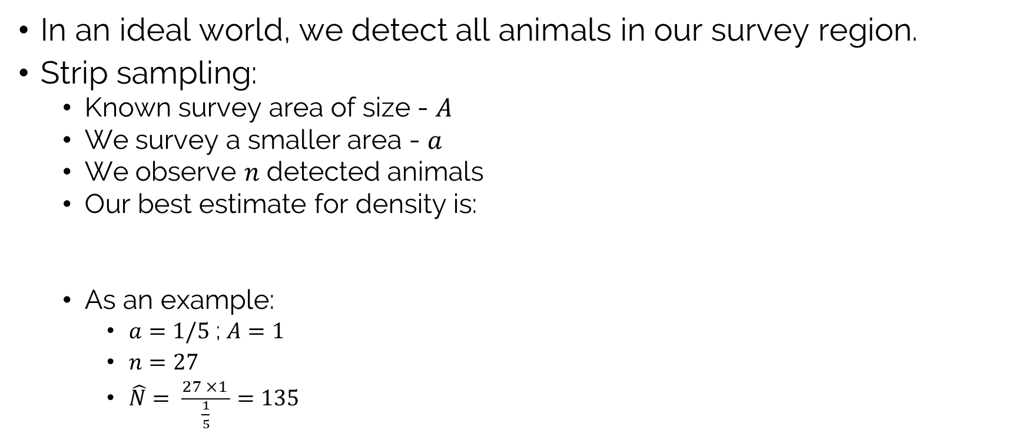
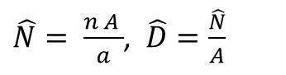
Standard Distance Sampling
In an ideal world, we detect all animals in our survey region.
Strip sampling:
Known survey area of size - $A$
We survey a smaller area - $a$
We observe $n$ detected animals
Our best estimate for density is:
As an example:
$a=1/5$ ; $A=1$
$n=27$
$\hat{N}= \frac{27 ×1 }{\frac{1}{5}}=135$
$\hat{N}= \frac{n A }{a}$, $\hat{D}=\frac{\hat{N}}{A}$
These types of estimators are called Horvitz-Thompson

Slide 5
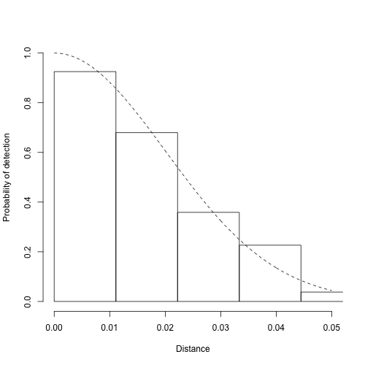
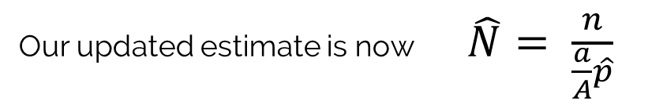
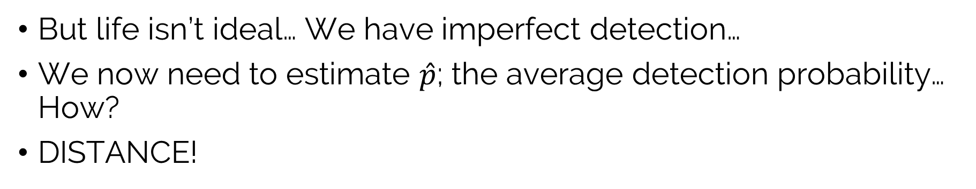
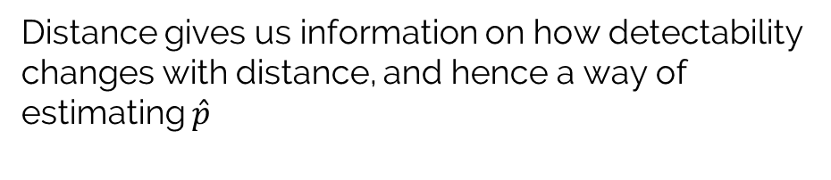
Distance sampling
But life isn’t ideal… We have imperfect detection…
We now need to estimate $\hat{p}$; the average detection probability… How?
DISTANCE!
Distance gives us information on how detectability changes with distance, and hence a way of estimating $\hat{p}$
The area under our detection function divided by the area of the rectangle gives us an estimate for detection probability
Our updated estimate is now $\hat{N}= \frac{n}{\frac{a}{A}\hat{p}}$

Slide 6
Distance sampling - Assumptions
All animals on the line are detected
Distances are measured accurately
Survey is a snapshot
Animals move slowly with respect to observers
Animals do not move before being detected
Animals are distributed independently of the line
This is the problem our research tackles
With responsive movement, the perpendicular distribution of the animals is not necessarily known! It is usually assumed to be uniform

Slide 7
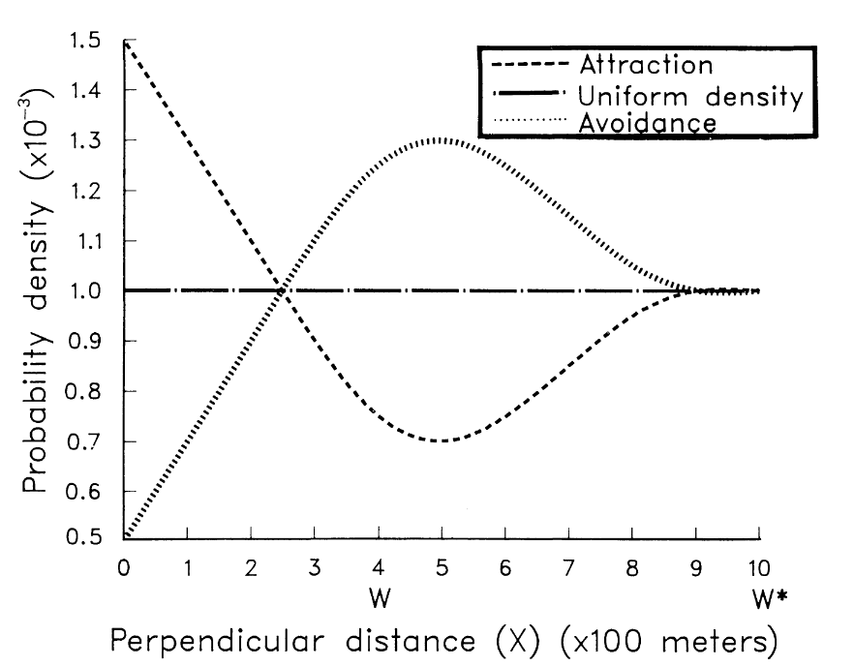
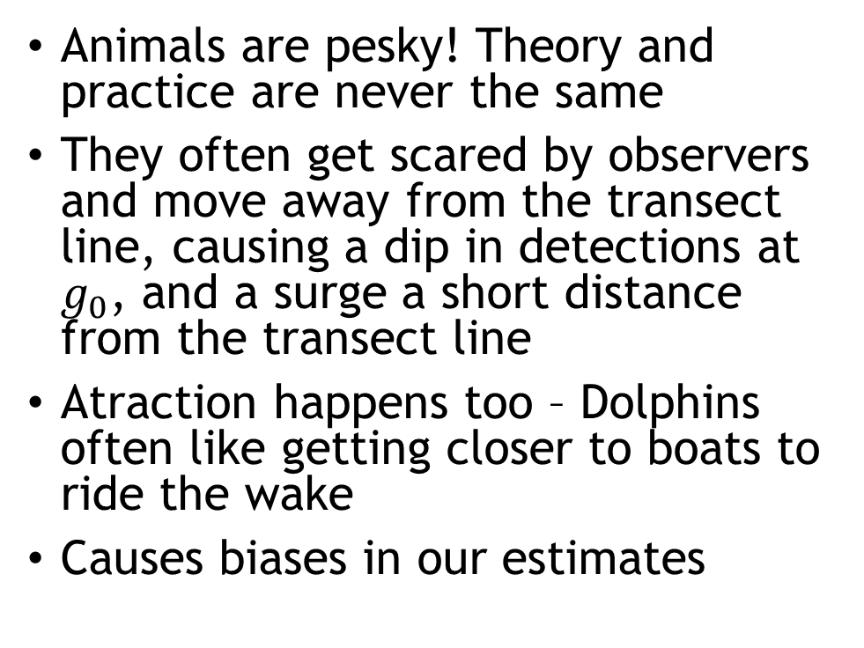
Responsive Movement
Animals are pesky! Theory and practice are never the same
They often get scared by observers and move away from the transect line, causing a dip in detections at $g_{0}$, and a surge a short distance from the transect line
Atraction happens too – Dolphins often like getting closer to boats to ride the wake
Causes biases in our estimates
Fig 1. Turnock and Quinn (1991)

Slide 8
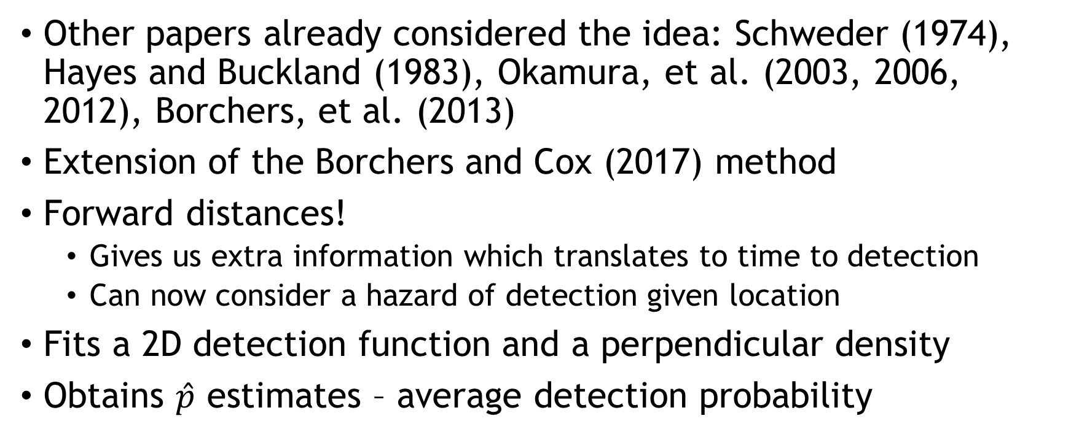
2D detection functions
Other papers already considered the idea: Schweder (1974), Hayes and Buckland (1983), Okamura, et al. (2003, 2006, 2012), Borchers, et al. (2013)
Extension of the Borchers and Cox (2017) method
Forward distances!
Gives us extra information which translates to time to detection
Can now consider a hazard of detection given location
Fits a 2D detection function and a perpendicular density
Obtains $\hat{p}$ estimates – average detection probability

Slide 9
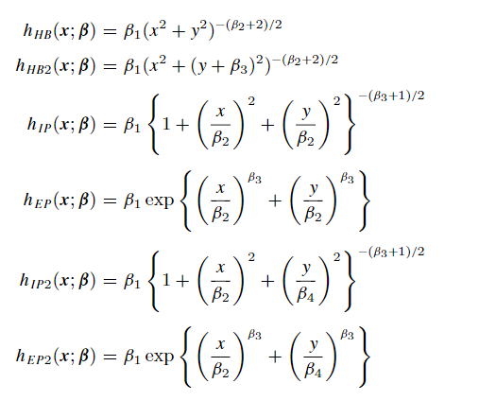
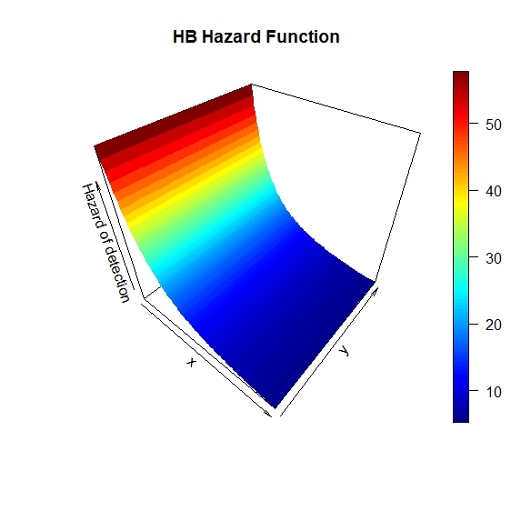
The Detection Functions
Borchers and Cox (2017)

Slide 10
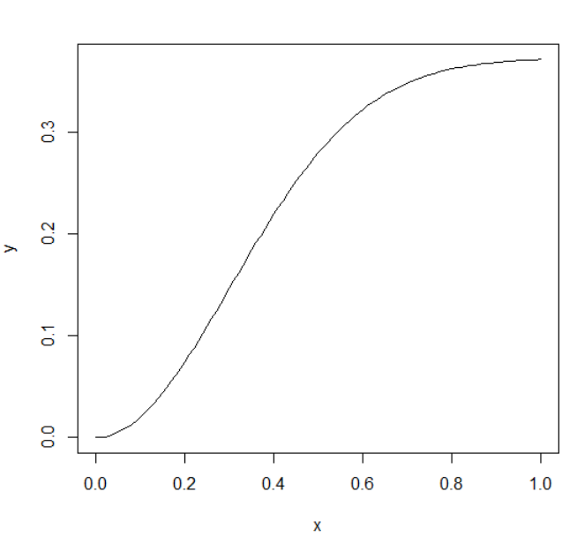
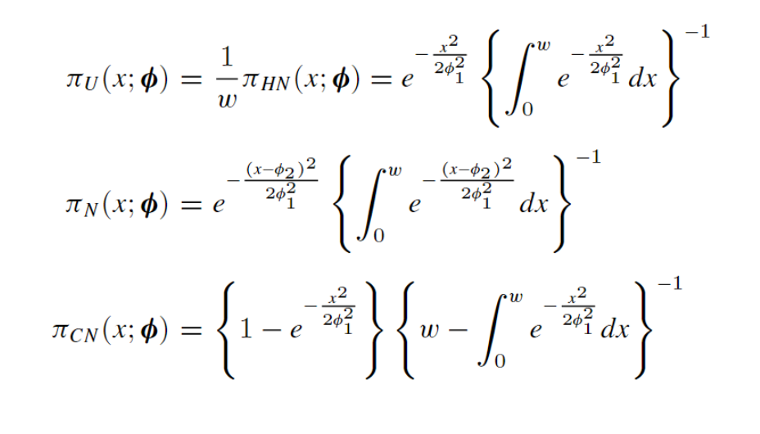
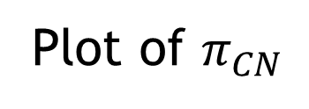
The Perpendicular Densities
Plot of $π_{CN}$
Borchers and Cox (2017)

Slide 11
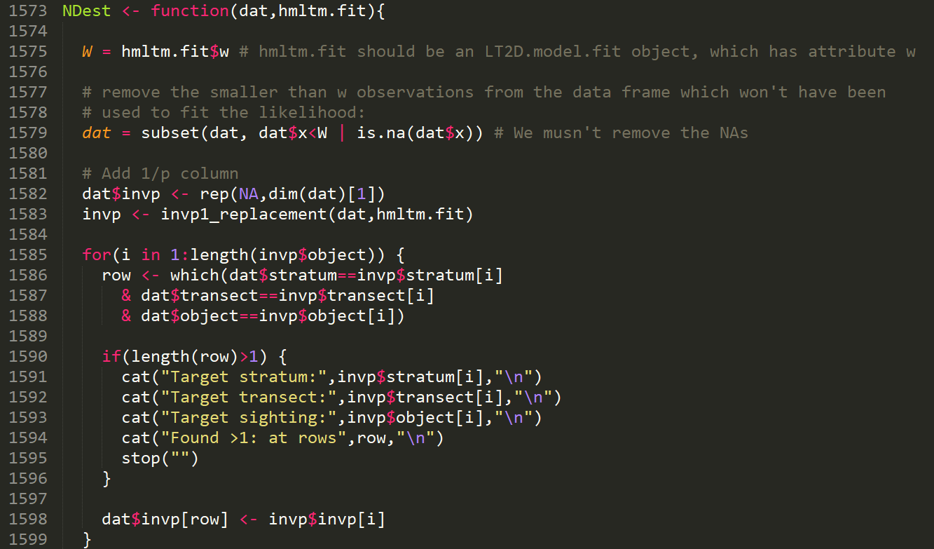
Adding in Abundance estimates
Code!
Spent a considerable amount of time:
Generalizing the old code
Adapting code from other Distance software
Merging code
Thinking of edge cases, protecting against them, and testing them

Slide 12
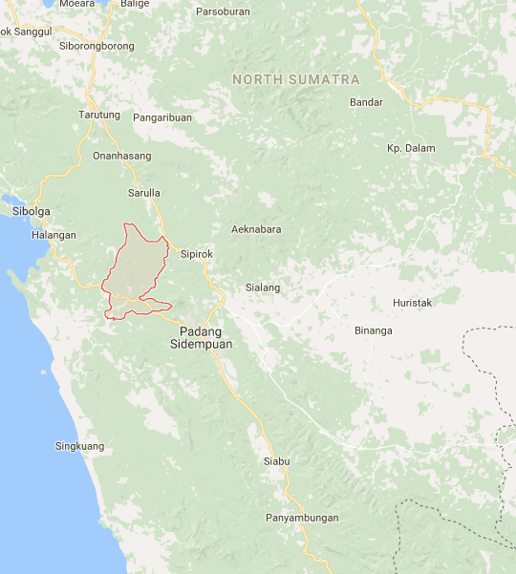
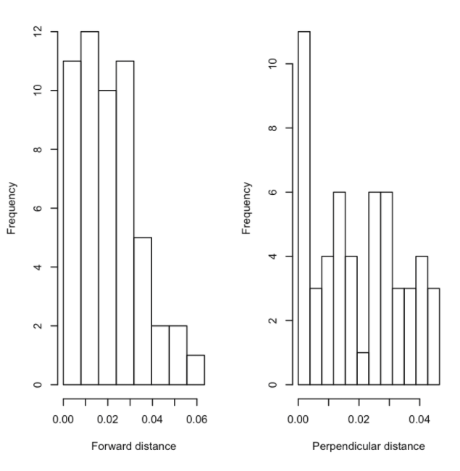
The Batang Toru Data
4 Km transect walked 52 times, for a total covered length of 208 Km
Our analysis focused only on the gibbons, with 54 detections
Sadly, all the best fitting models had a uniform perpendicular density function
This means there is little evidence of responsive movement and the CDS abundance estimates are likely to be more trustworthy
Indonesian data set of two species, Gibbons and Siamangs

Slide 13
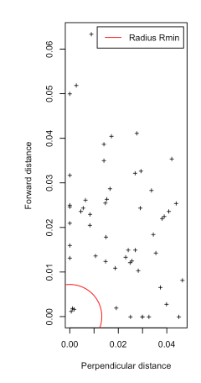
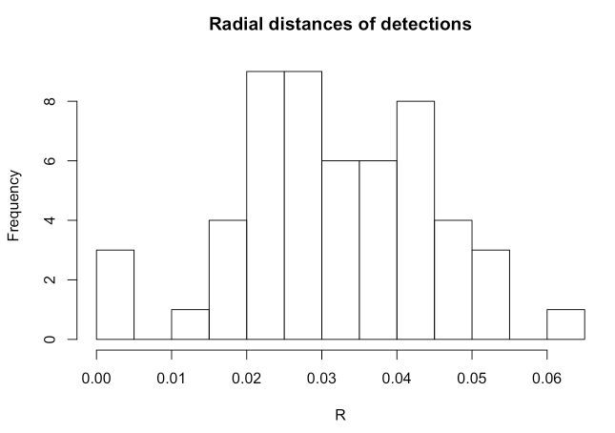
Angles rounded to 0 – The problem:
We have no idea where in the circle the observations truly were
BIAS!!! ☹

Slide 14
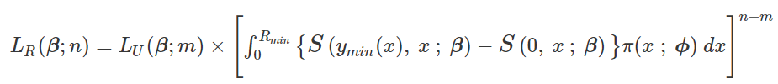
Angles rounded to 0 – The Solution:
The modified likelihood:
Not as scary as it looks!
It describes the probability the animal was first detected in the quarter circle from the previous slide, to the power of the number of animals that were detected in this region

Slide 15
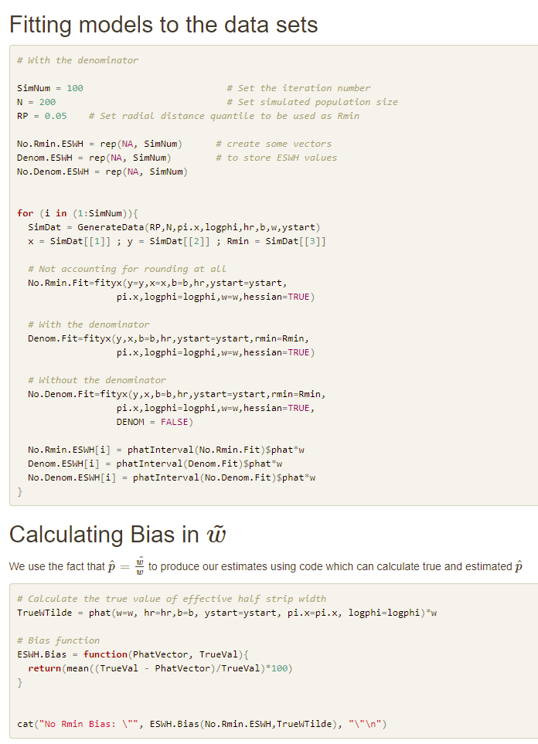
Simulation Study
Simulations with different settings:
Sample size
Perpendicular distribution
True detection function
Simulation repeats
Inclusion of the uncertain denominator
The general trend we observed was a bias reduction from around 20% to 3% using the modified likelihood…
Except… No help for Batang Toru, back to the drawing board!

Slide 16
Covariate Inclusion
Why is it needed?
Allows us to explain some of the observed variance
Narrower confidence intervals
Better fits by AIC
Allow us to investigate ecological factors of interest
Allows us to pool together data from various species.
Use all of the data for the detection function
Combined abundance estimate

Slide 17
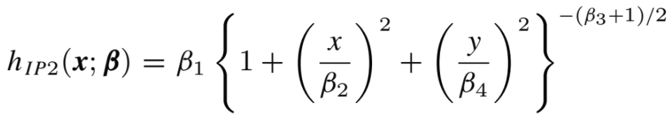
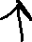
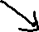
Covariate Inclusion – How we did it
Allow the choice to remain primarily with the user:
Three places to introduce the relationship:
The intercept
The X axis
The Y axis
Wanted all combinations to be possible
With different formulas for each
Spoiler:
It took a lot of code

Slide 18
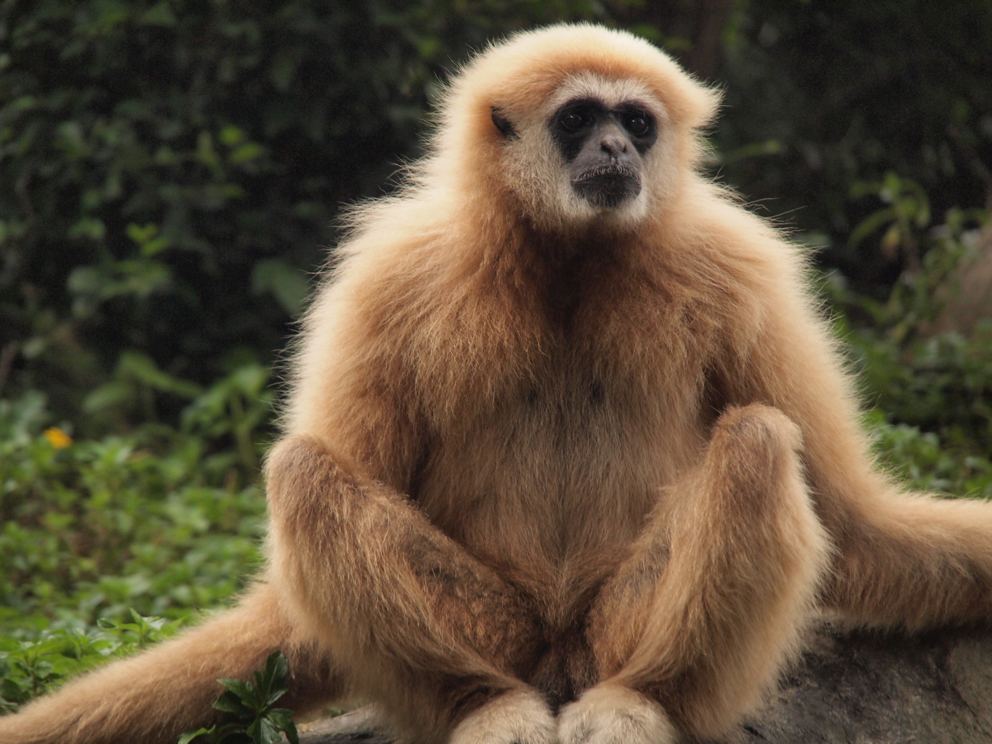
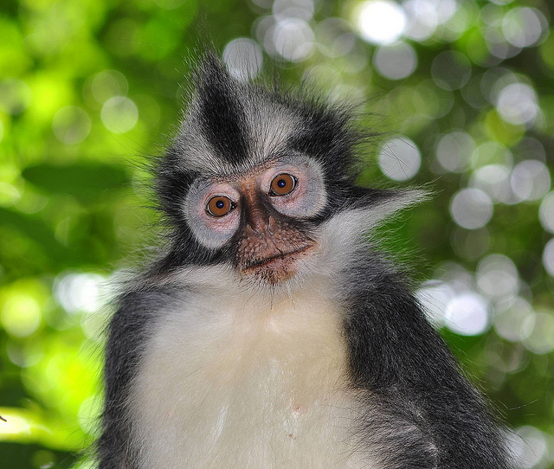
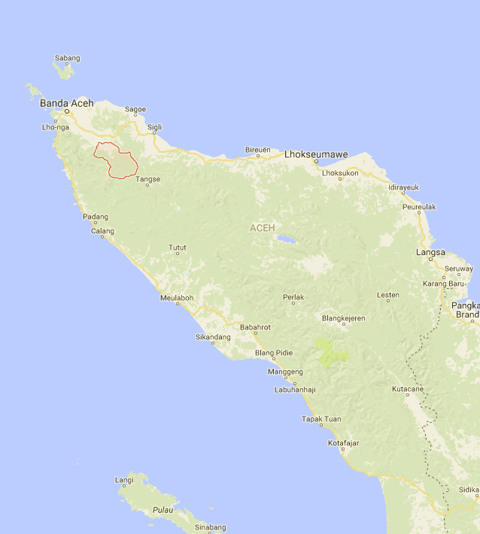
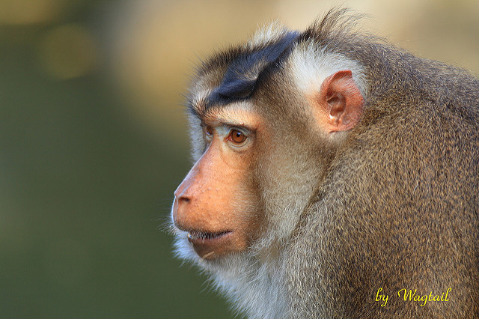
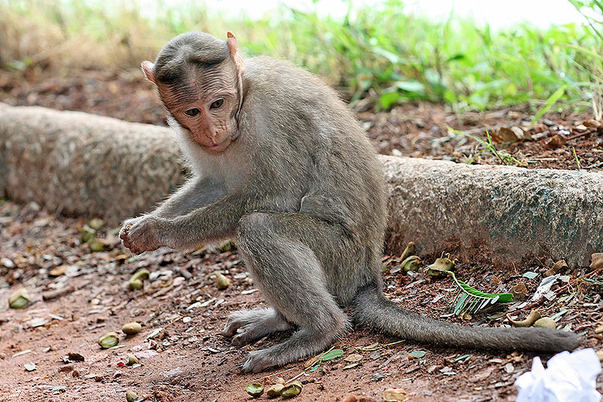
Jantho Data
Indonesian Primate data
101 Km of transect
127 detections
4 Species:
Hylobates lar
Presbytis thomasi
Macaca nemestrina
Macaca fascicularis

Slide 19
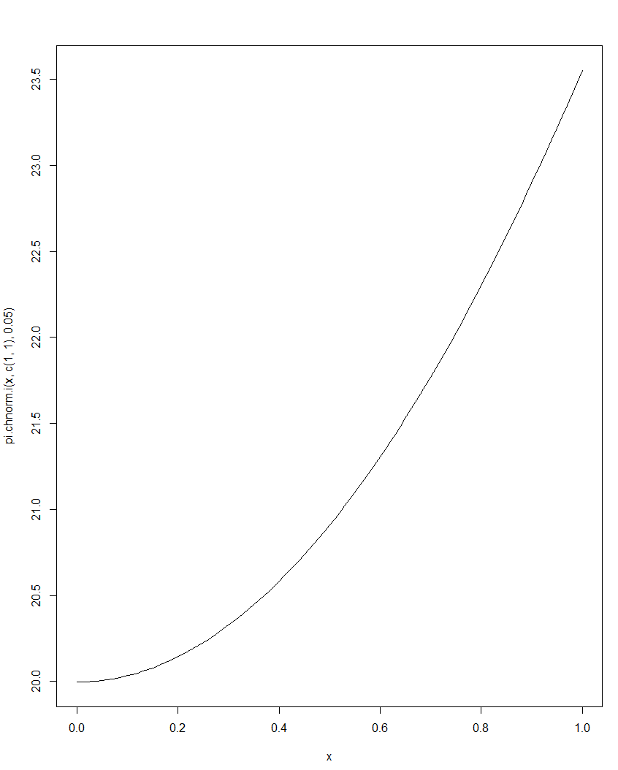
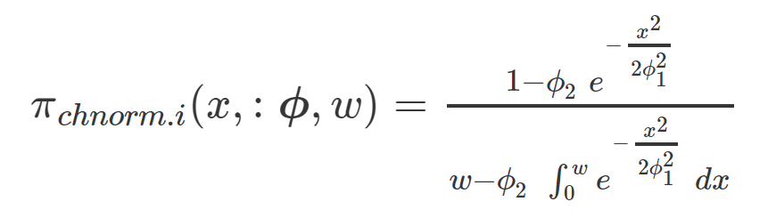
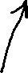
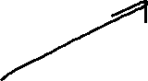
New Perpendicular Density – chnorm.i
Analyzing the Jantho data, it became clear that a reparameterization of the half-normal perpendicular density was required, to allow for non-zero abundance on the transect
Logit link
Log link

Slide 20
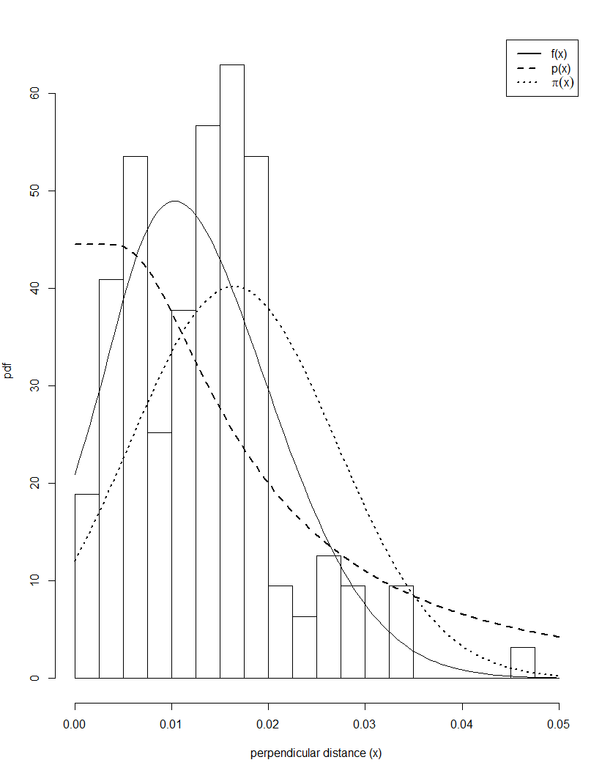
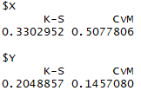
Jantho Results
Covariate inclusion was not significant by AIC
Best model by AIC had a standard Hazard Rate detection function and a normal (bump) perpendicular density
Models with uniform perpendicular density did poorly :
Strong indication that responsive movement is present!
Abundance estimate of 220 animals (of all four species combined) in the surveyed area
Non-parametric goodness of fit suggests it fits the data well

Slide 21
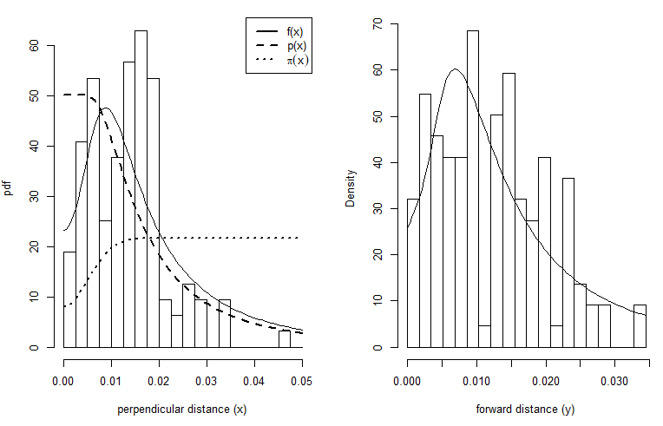
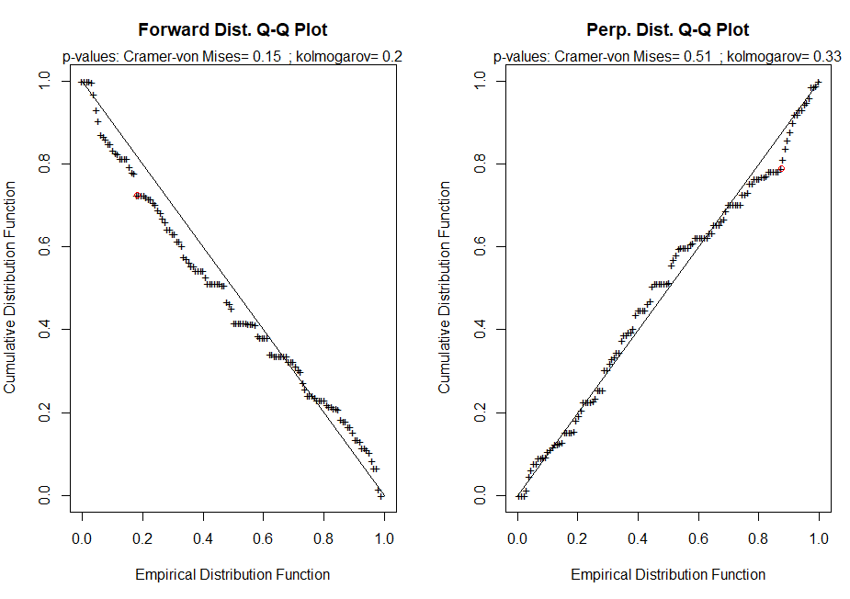
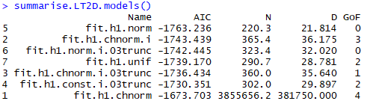
Ease of use and User interaction
S3 classes: Plotting function
Single Goodness of Fit function
Optional Ticks and Graph
Model collecting function
- Model summary function

Slide 22
Moving Forwards
Bootstrap confidence intervals (non-parametric)
Choice of resampling from transects,
Or resampling fitted parameters from the multivariate normal distribution implied by the properties of MLEs
Consider mixture models
Deals with populations made of inhomogeneous subpopulations, each with different behaviours which affect detection probability
More work on covariates:
Goodness of fit
More elegant plotting functions
Make the LT2D R package release ready
Working with ecologists in workshops or as consultants to introduce them to 2D detection functions and how they can help with their study

